Slide 1

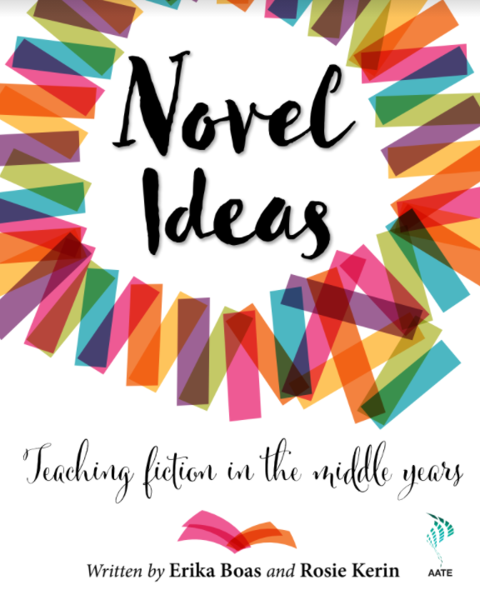

Novel Ideas: Teaching fiction in the middle years
Teaching fiction in the middle years
Erika Boas
Notes:
Introductions: 2mins

Slide 2
Acknowledgement of Country
We gather for this meeting physically dispersed and connected virtually. Let us reflect on the meaning of place and in doing so acknowledge the Aboriginal community as the traditional and original owners, and continuing custodians of this land. We pay respect to Elders past, present and emerging.

Slide 3

Key purpose
How are we using novels to enrich the imaginations, language, and intellectual minds of our students?
How are our students reading and engaging with the novels we promote and teach?
How are we setting up creative and collaborative reading spaces where ‘our students feel safe and valued as members of a meaningful, rewarding and interpretive community’? (Manuel, 2012, p. 267)
And how do we, as teachers, take a step back when necessary to allow our adolescent students to take the lead in the ways they think, talk, and therefore learn about novels in the English classroom?

Slide 4
Key messages: two theoretical chapters
‘Teaching novels’ and ‘Selecting novels’
The importance of wide reading
Reading for pleasure as well as reading for intellectual growth and challenge
Avoiding ‘readicide’
Understanding the ‘fiction effect’
Championing the ‘adolescent reader’ and all that this entails
The importance of novel selection.

Slide 5
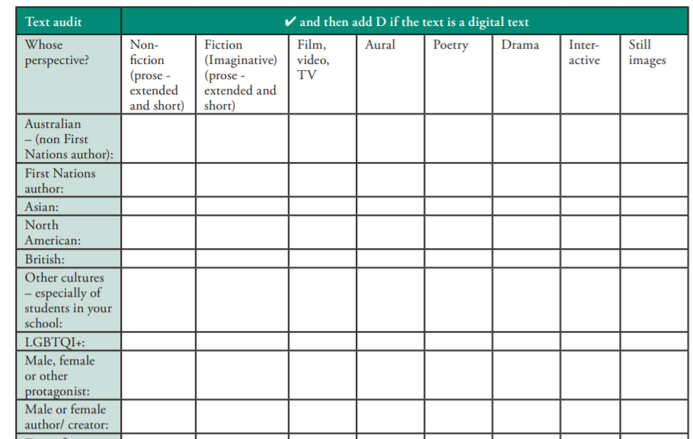
Selecting novels
Text audit:
Collaborative exercise for an English faculty.
(p.24 auditing tool)

Slide 6
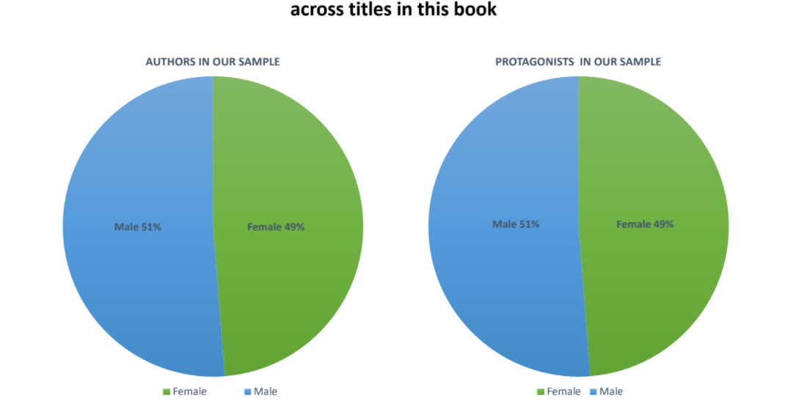

Slide 7
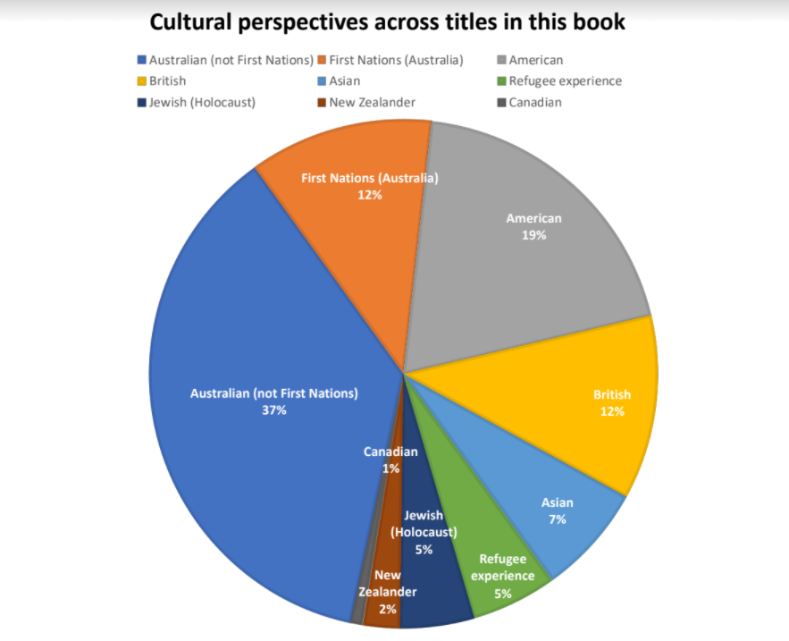

Slide 8
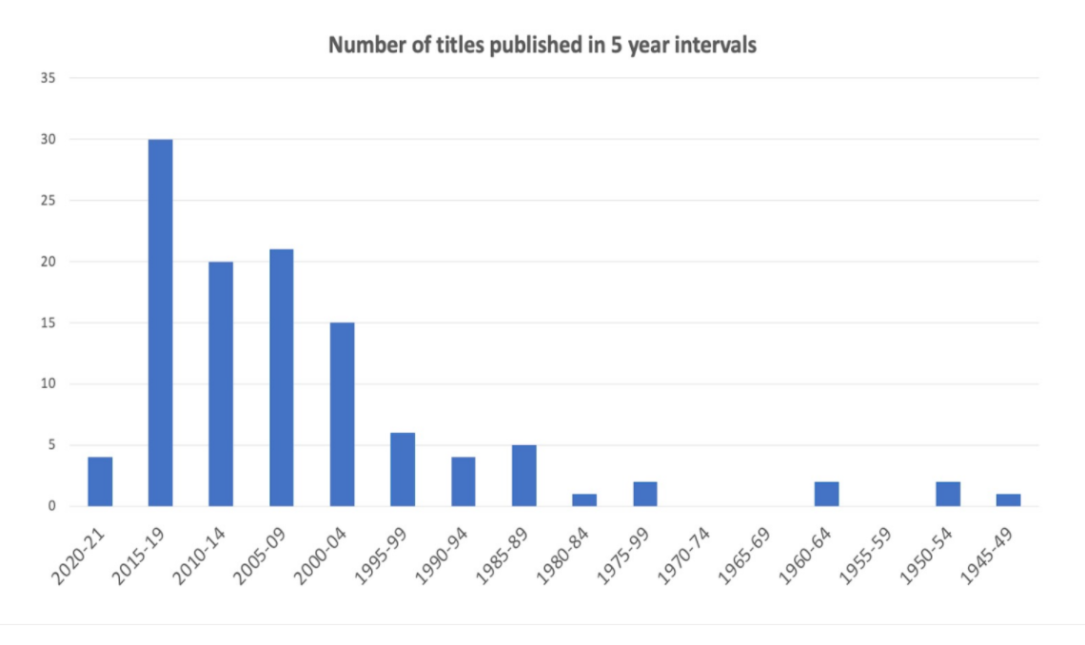

Slide 9
More practical chapters
Launching novels and building contexts
Supporting independent, capable readers
Establishing a collaborative reading culture
Using novel extracts
Teaching narrative elements
Teaching the literary genre

Slide 10
Instructional approaches
Engaging hooks and novel launches: e.g. quote mingles, opinionnaires, simulations.
Collaborative approaches: literature circles/ book club pedagogy
Forensic reading: close reading, scaffolding, focus on language, making connections, narrative elements and literary genre.
Transfer/ demonstrations of understanding: creative assessment ideas that are not ‘mini-me senior school preparatory tasks’.
(P.15 vignettes)

Slide 11
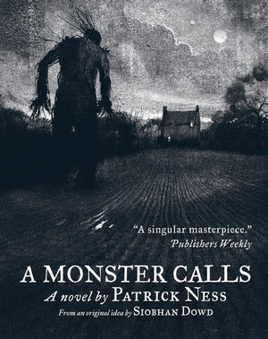
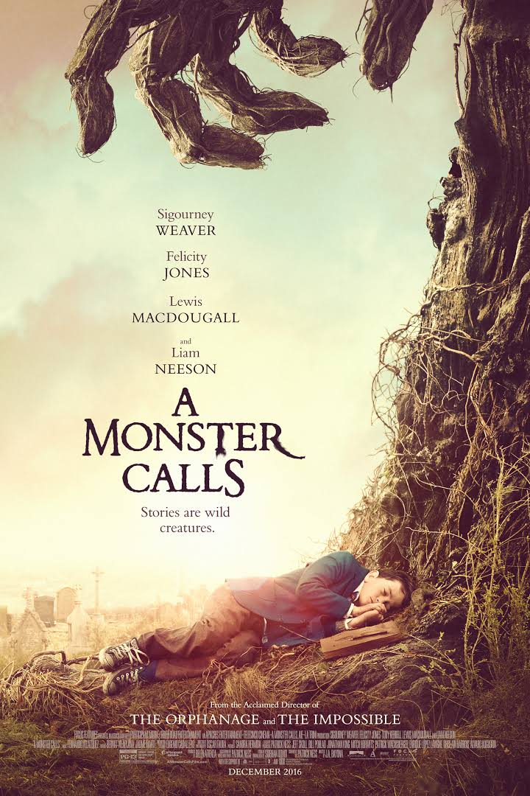
Engaging hook: Quote mingle
A Monster Calls by Patrick Ness
Novel (2011)
Film (2016)
(if possible have 1 quote per student or 1 per every two students so they can pair up)
(p.43 quote mingle)

Slide 12
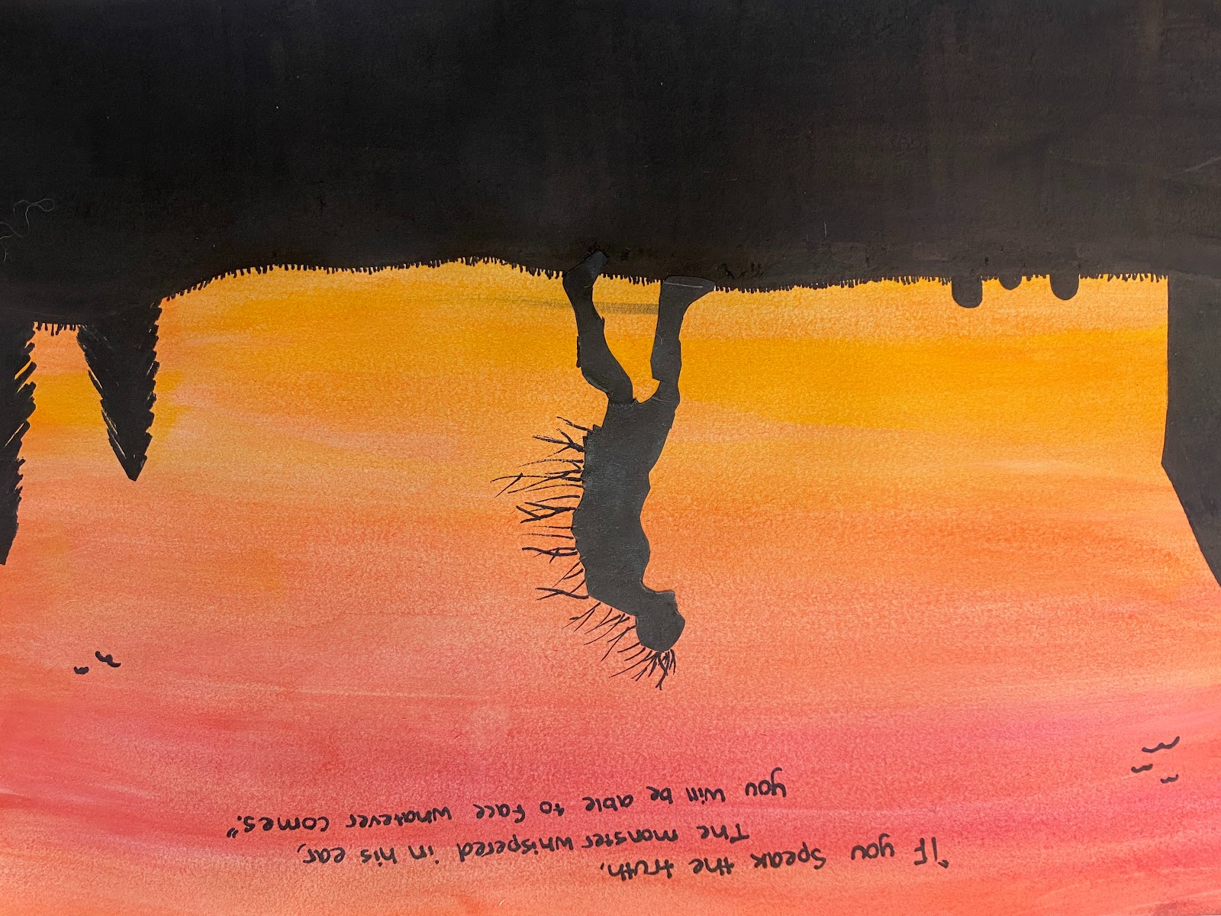
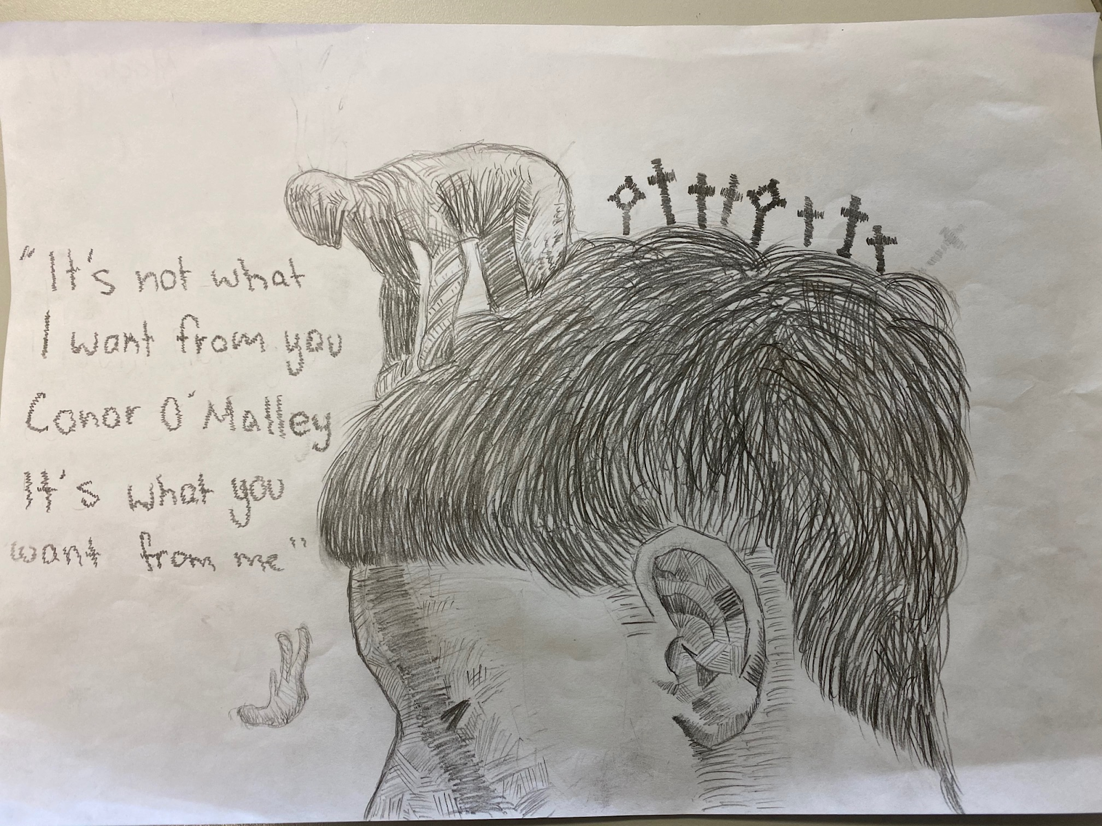
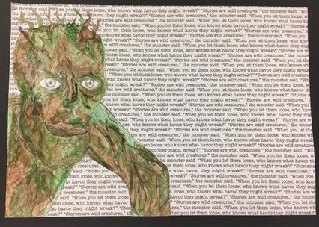
Illustrate a quote
“It’s not what I want from you, Conor O’Malley.
It’s what you want from me.”
“Stories are like wild creatures,” the monster said. “When you let them loose, who knows what havoc they might wreak?”
“If you speak the truth,” the Monster whispered in his ear behid him, “you will be able to face whatever comes.”

Slide 13
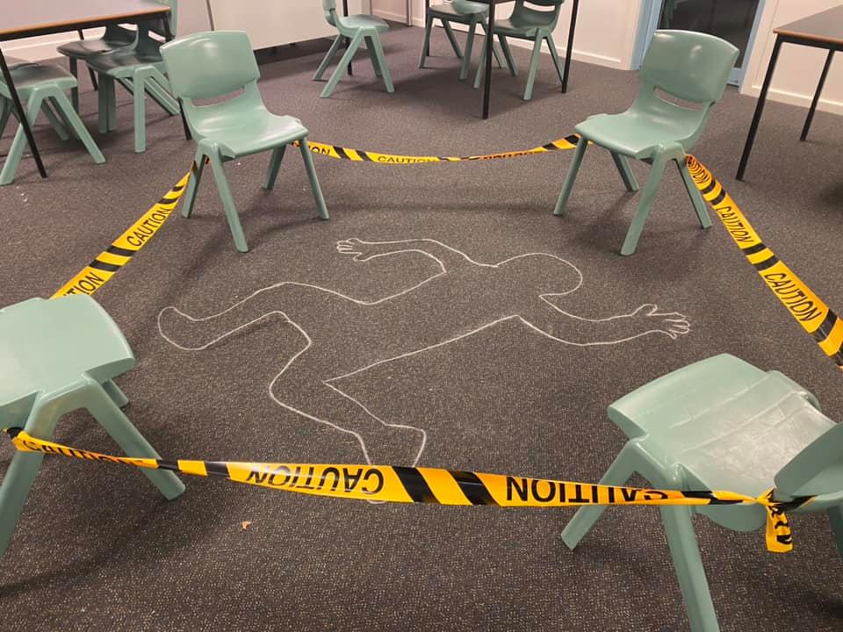
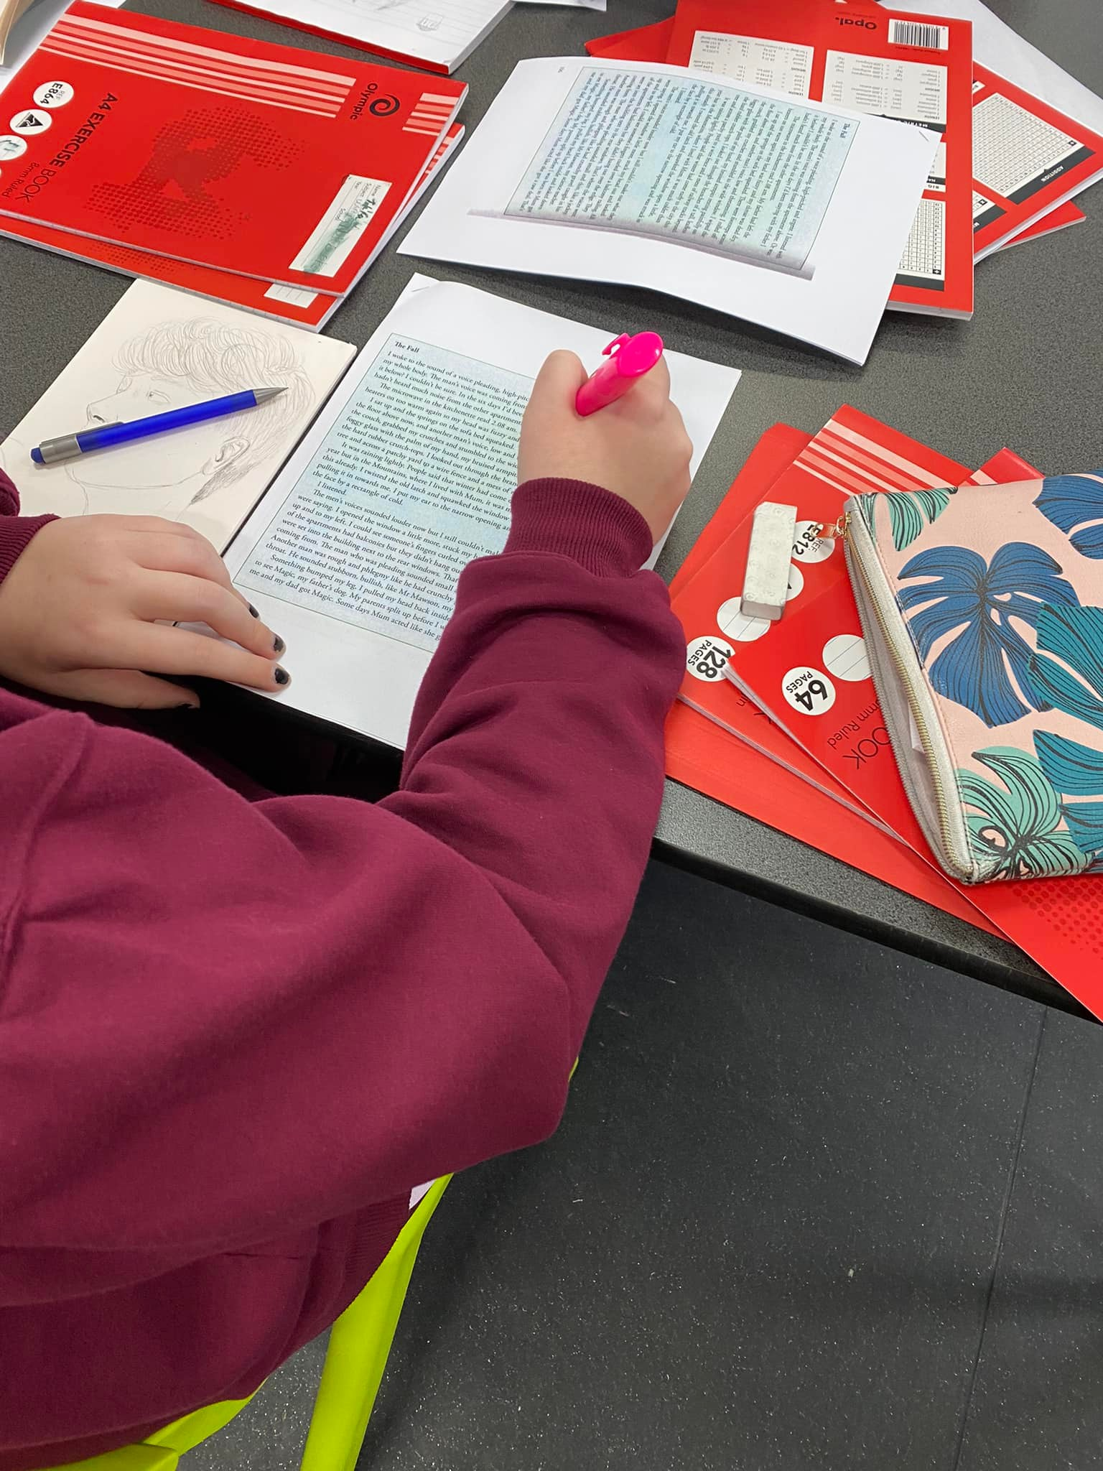
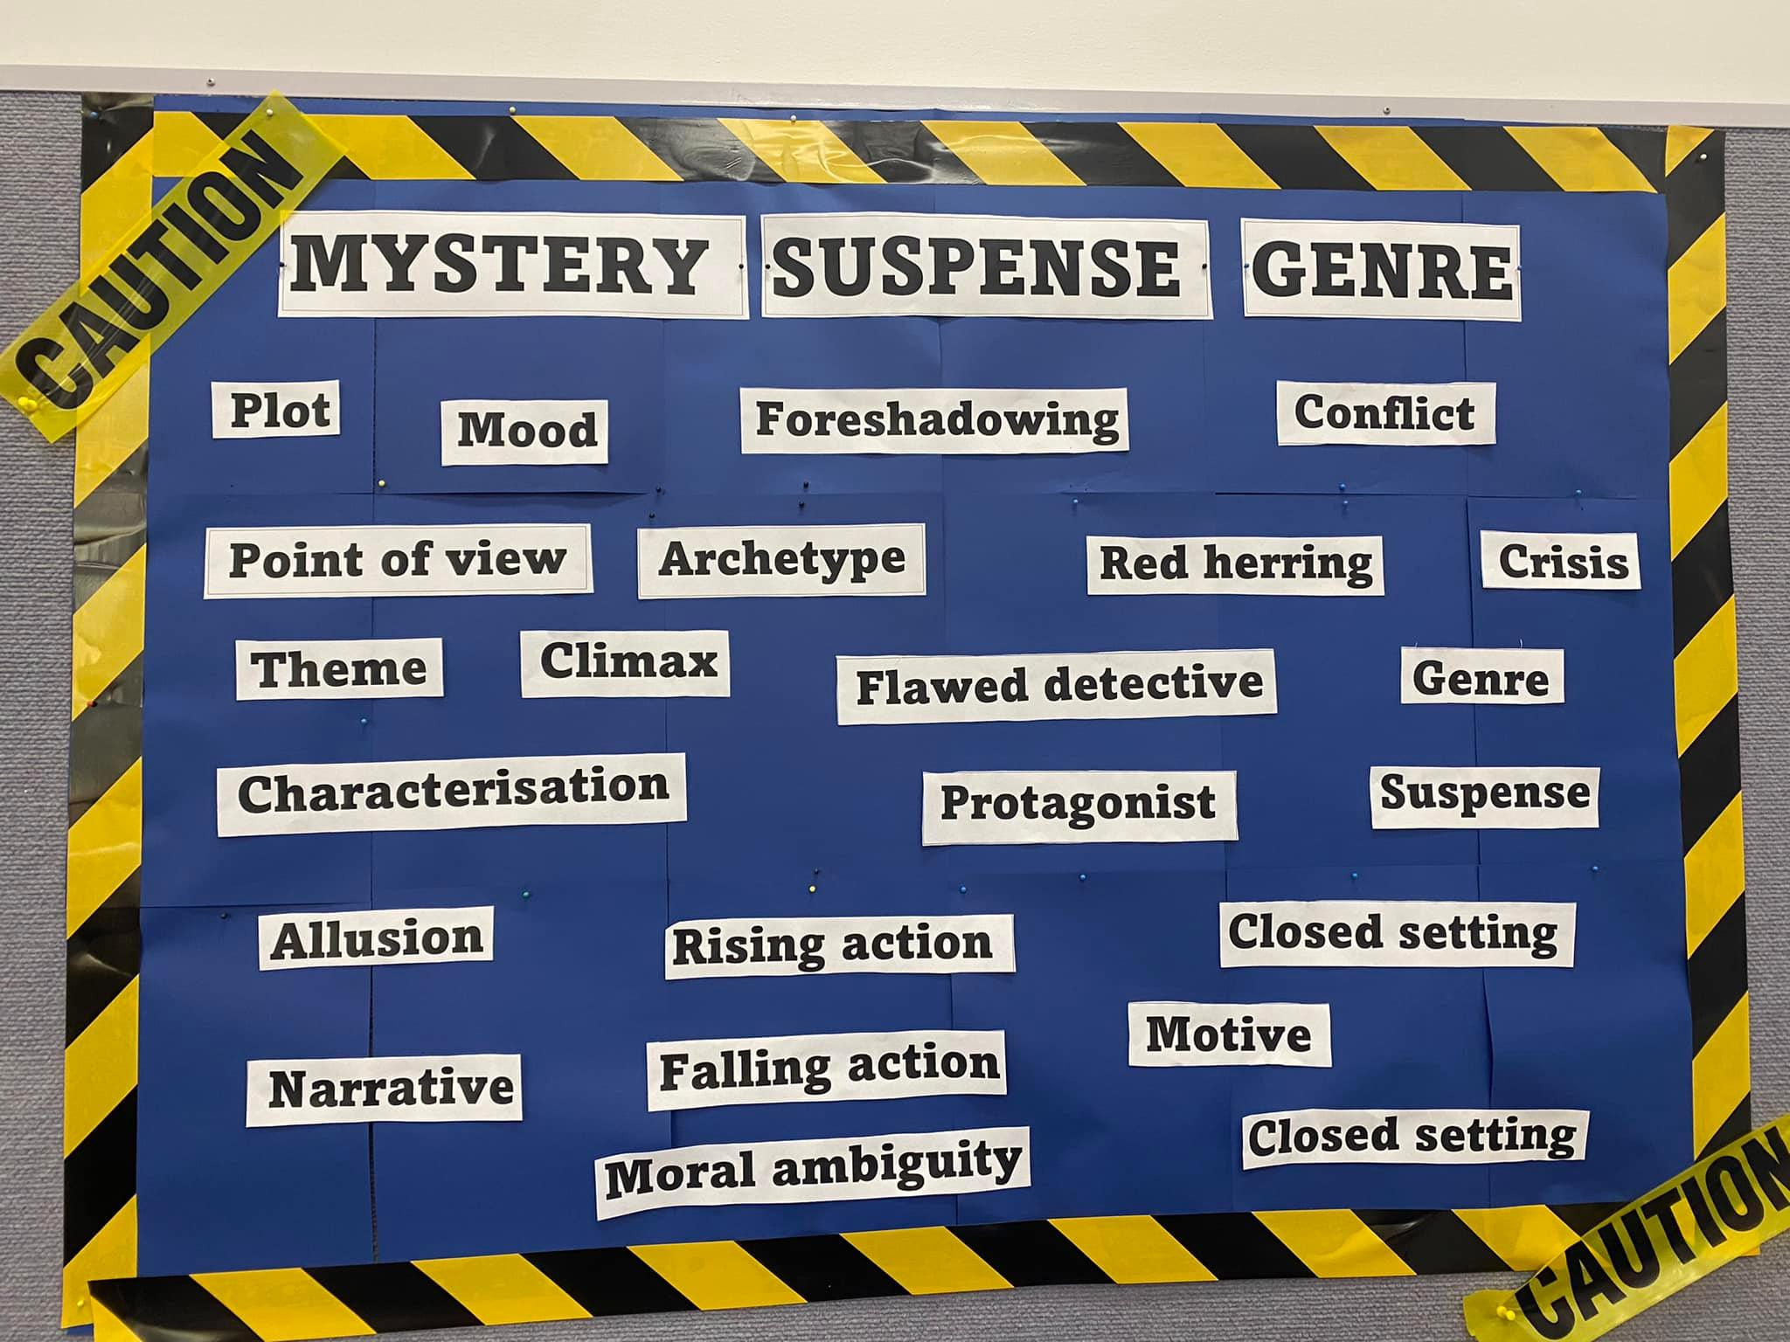
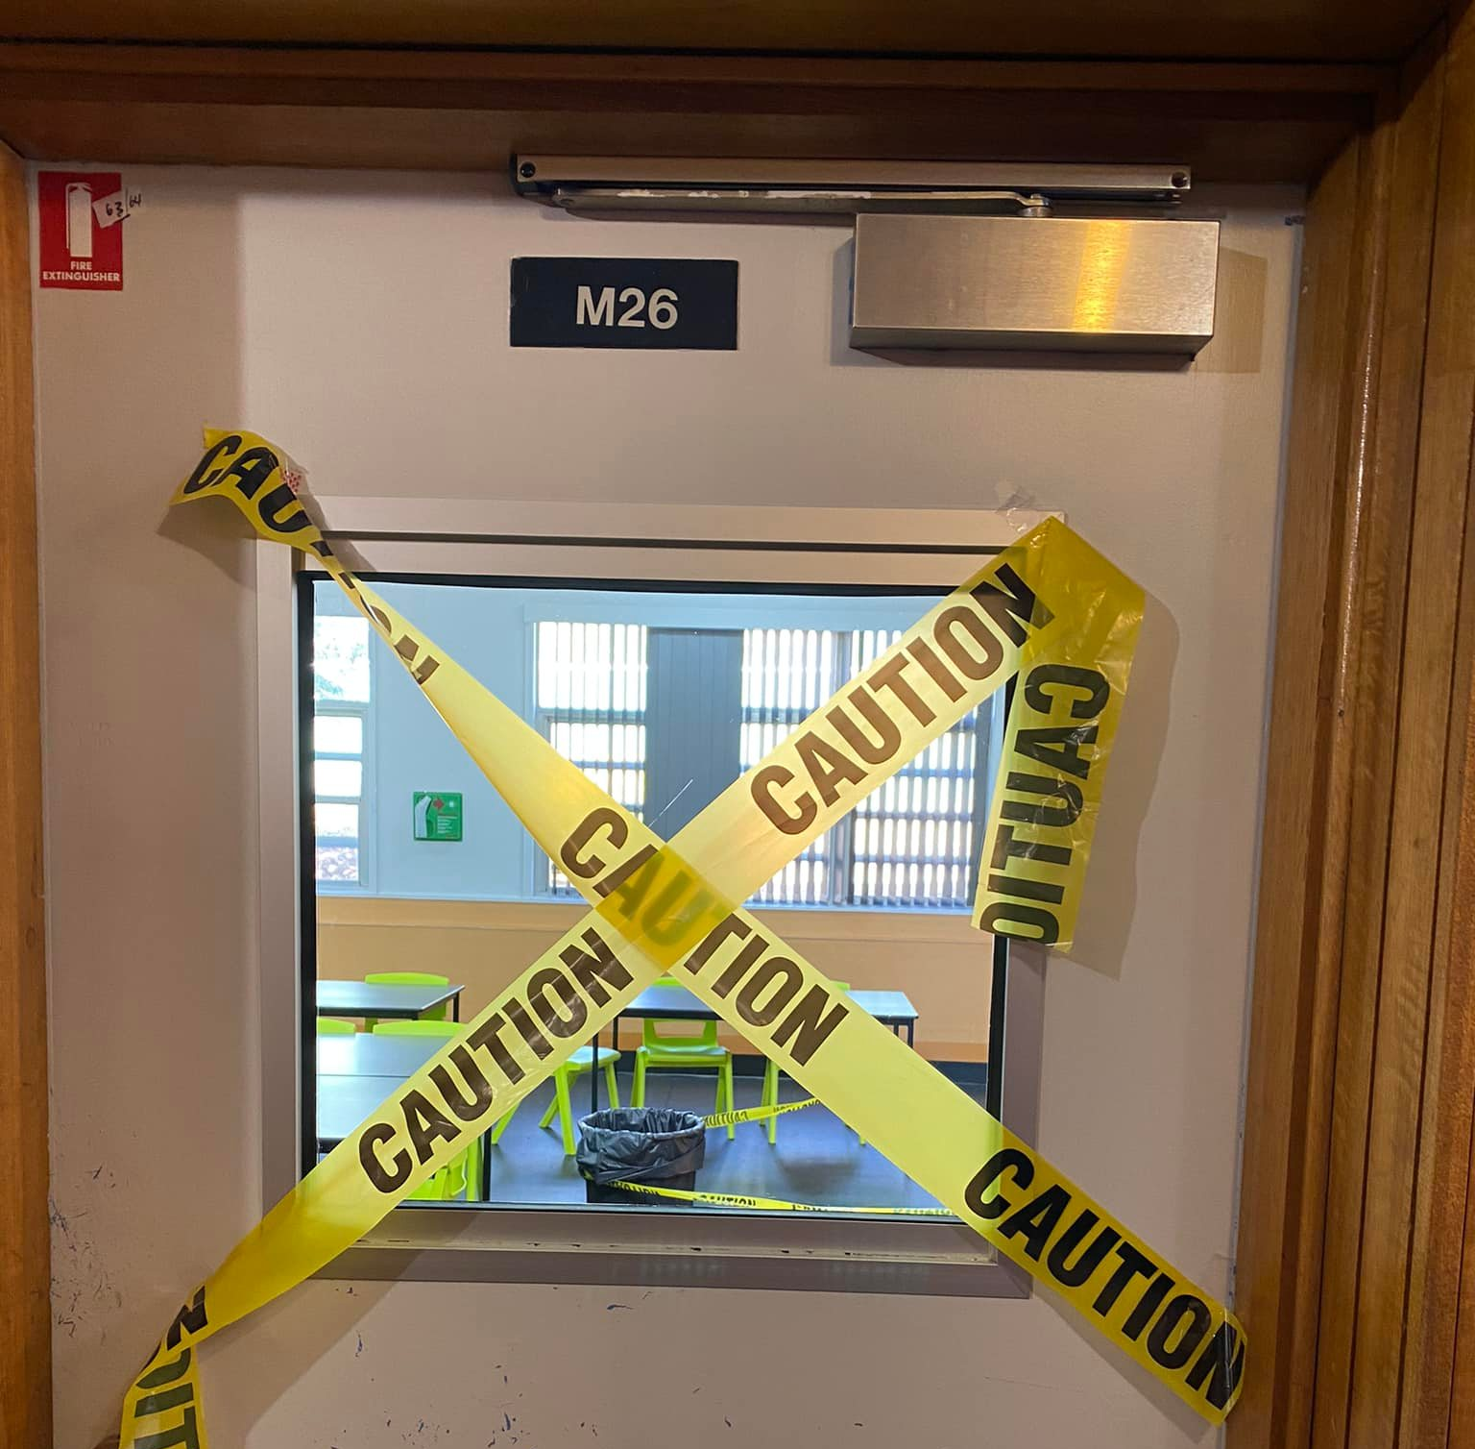
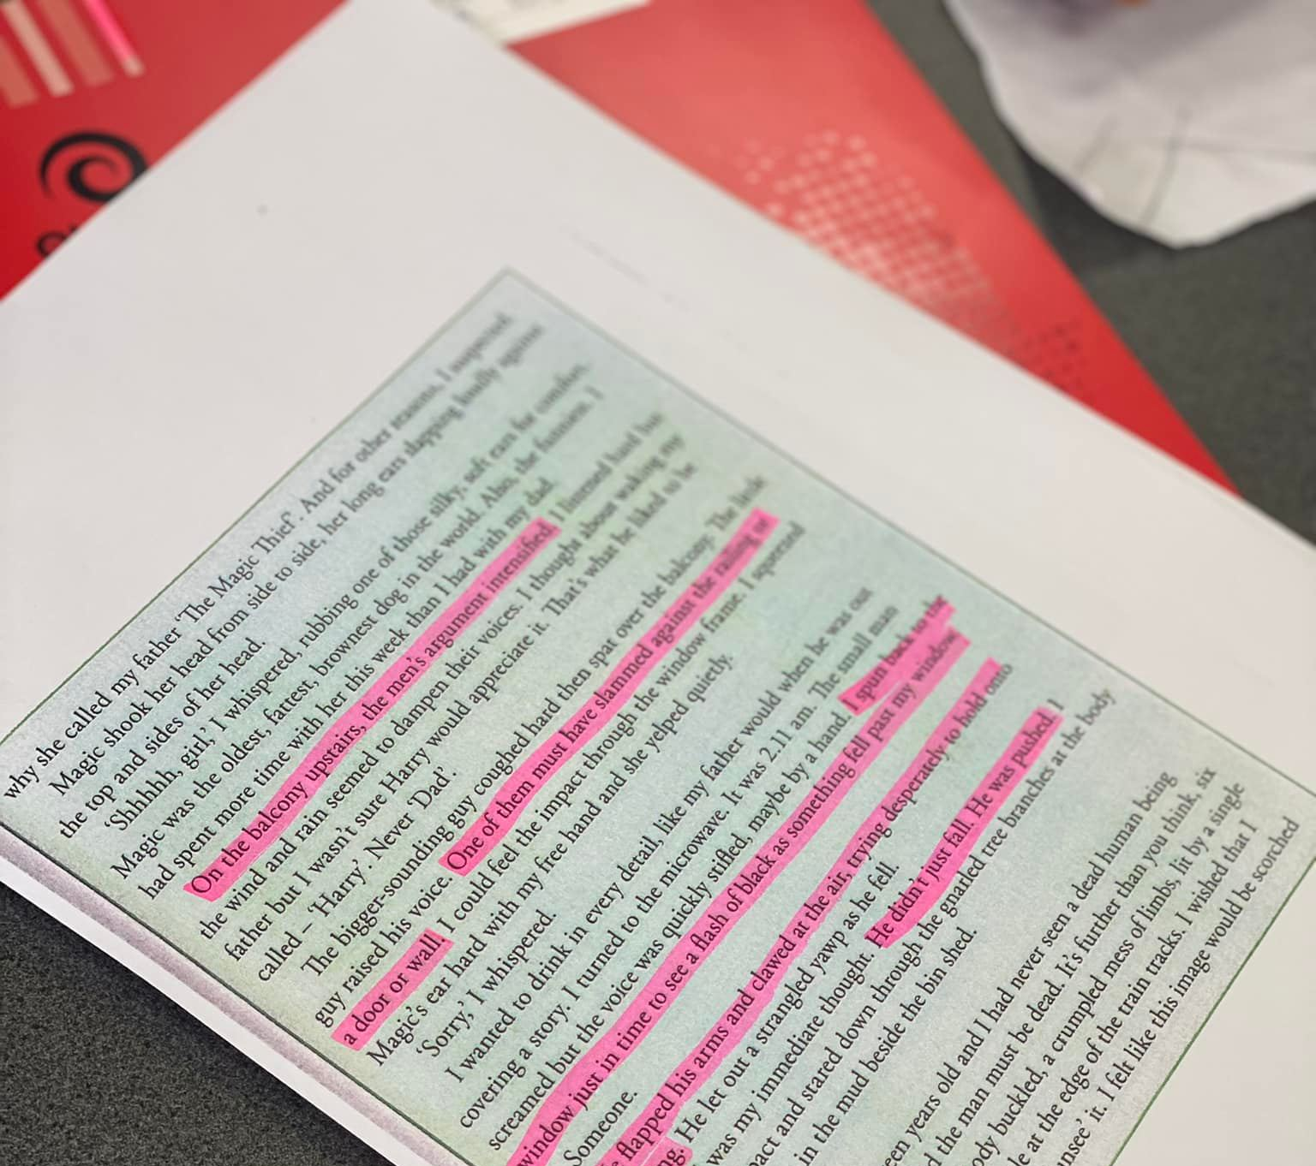
Simulations

Slide 14
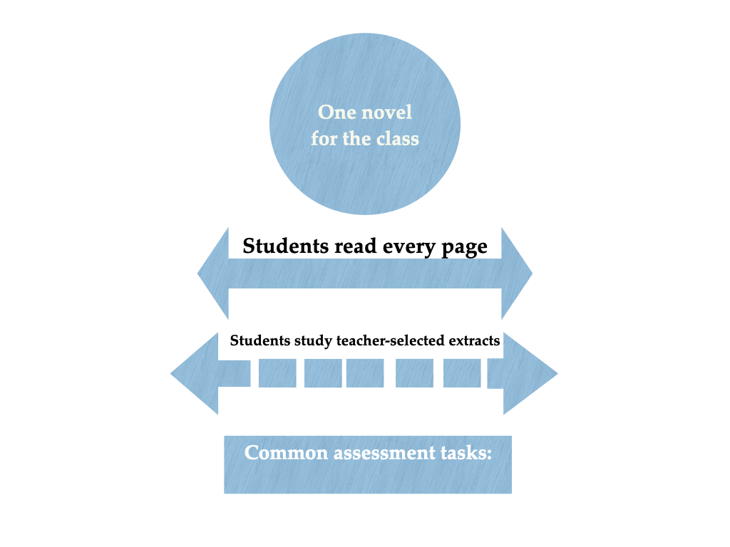
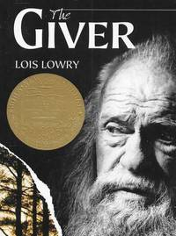
(p. 84 Book club pedagogy)

Slide 15
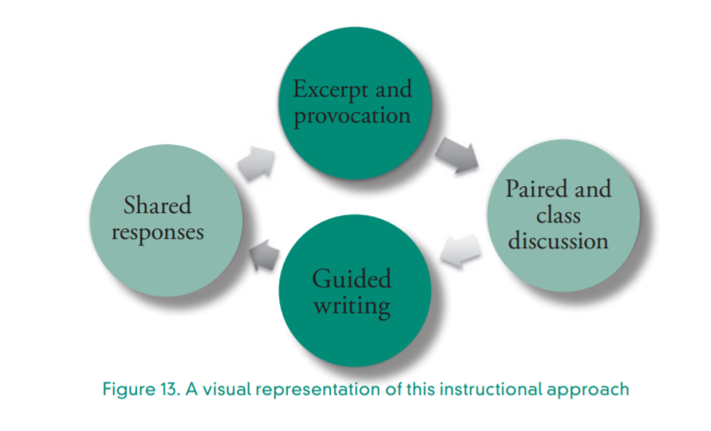

Slide 16
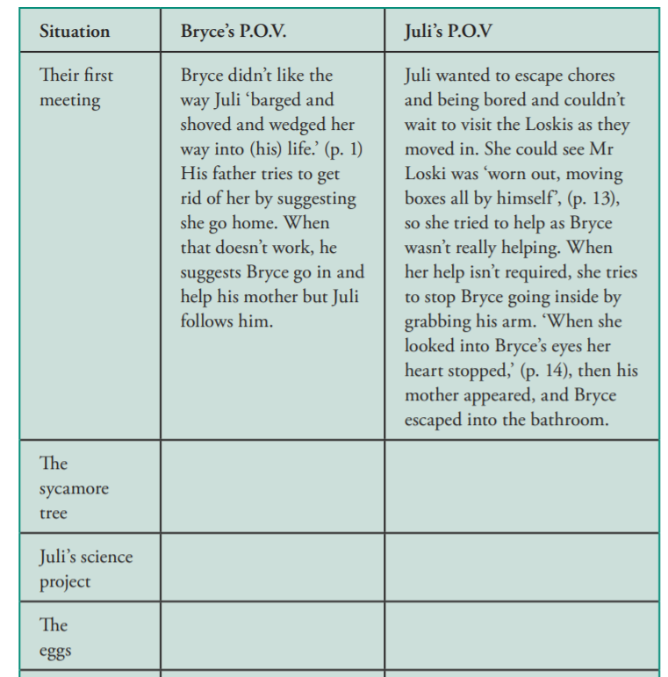
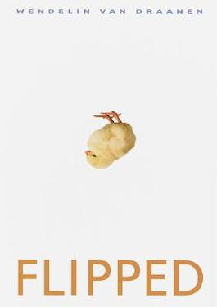
(p.131)

Slide 17

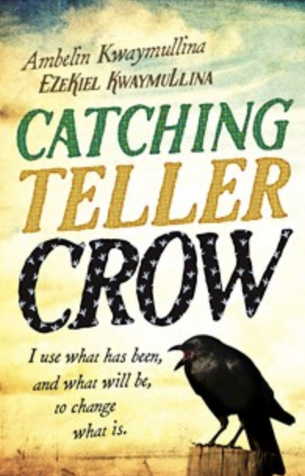
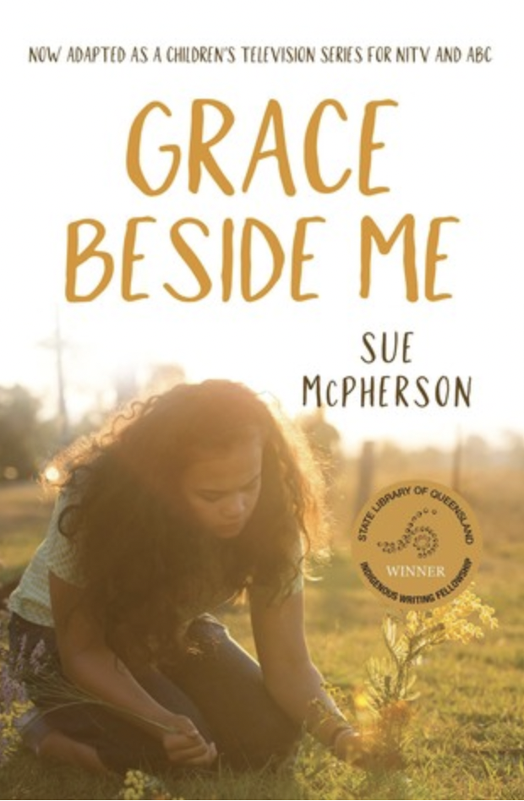
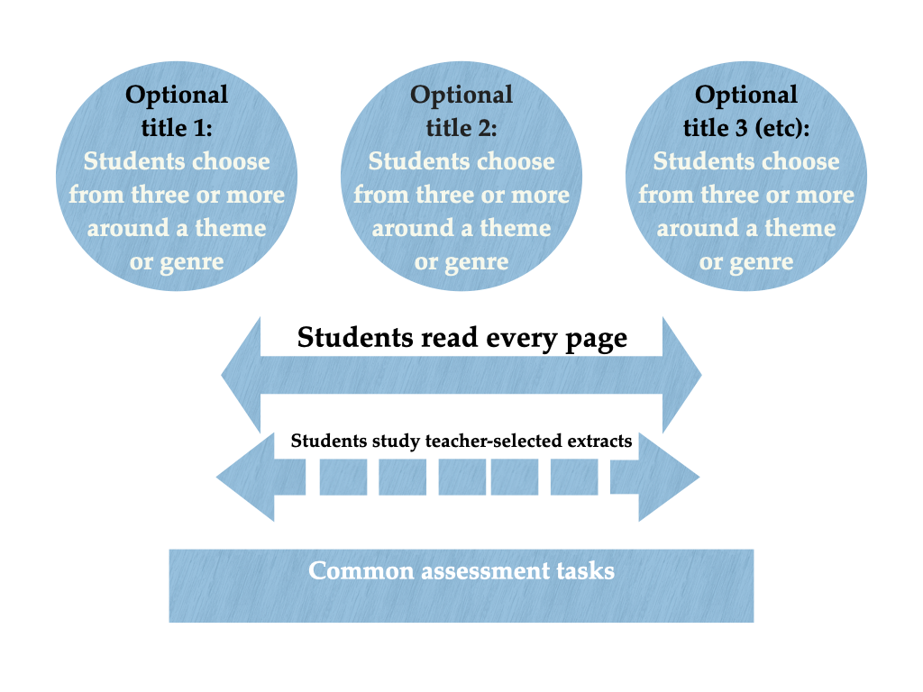


(p. 90 Literature circle example)
Notes:
Rosie – 4 mins

Slide 18
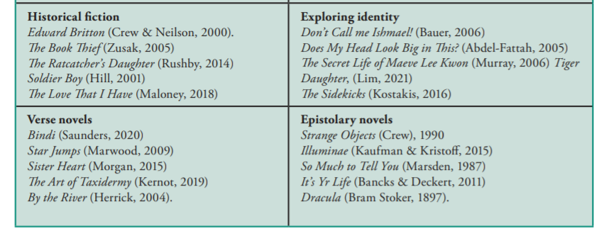
(pp. 98-99)

Slide 19
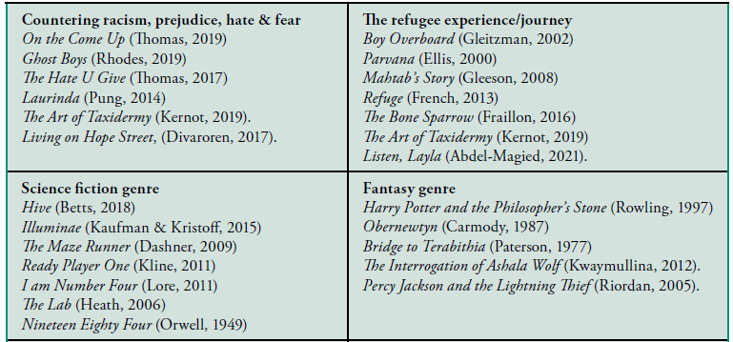

Slide 20
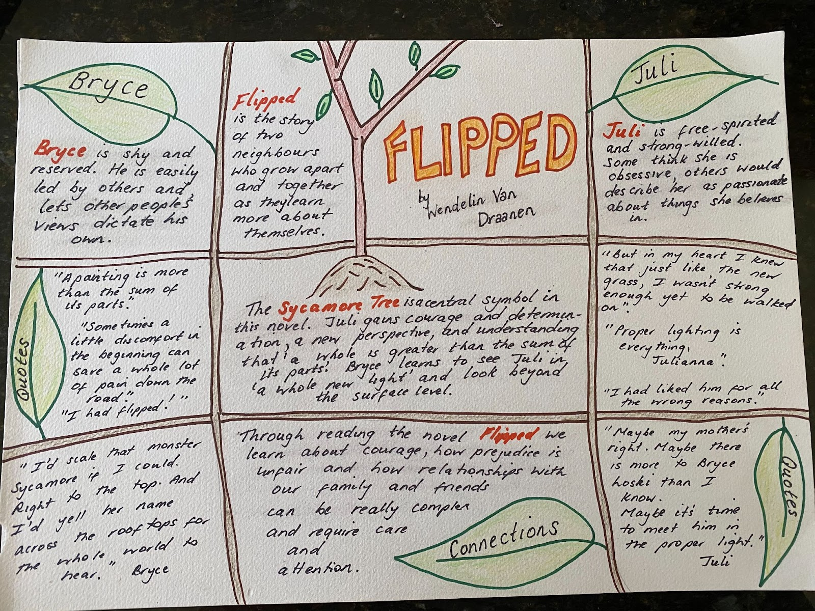
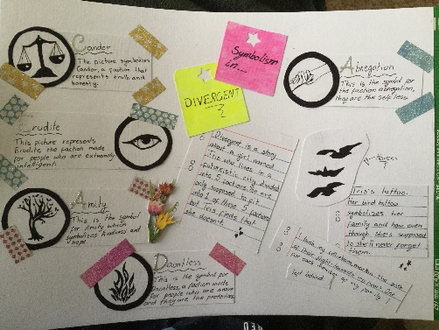
One pagers

Slide 21
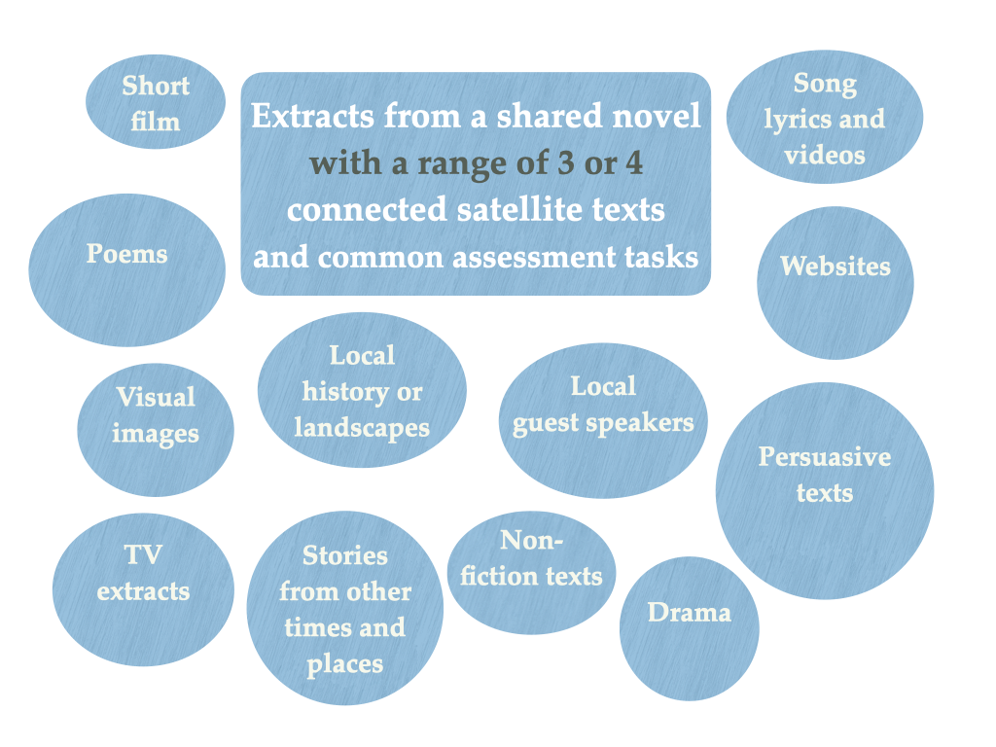
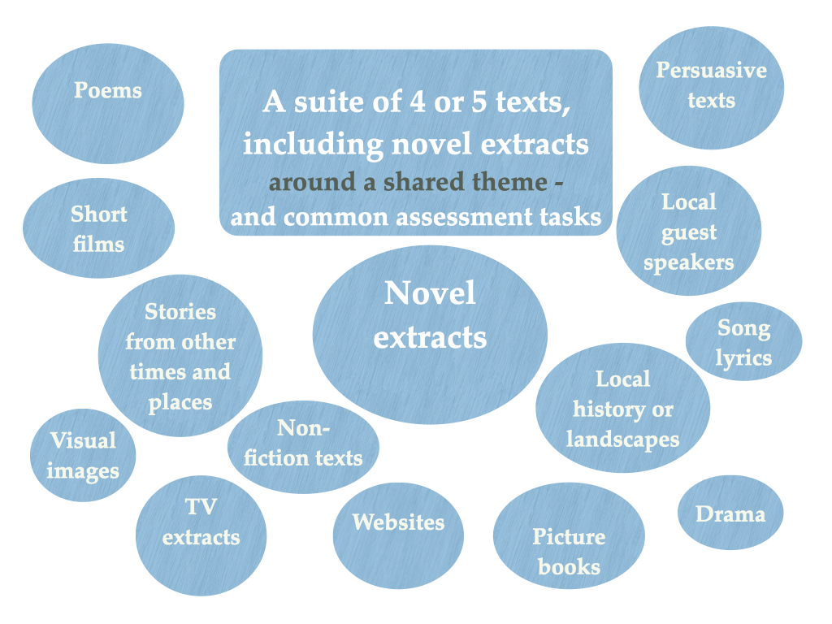

Slide 22



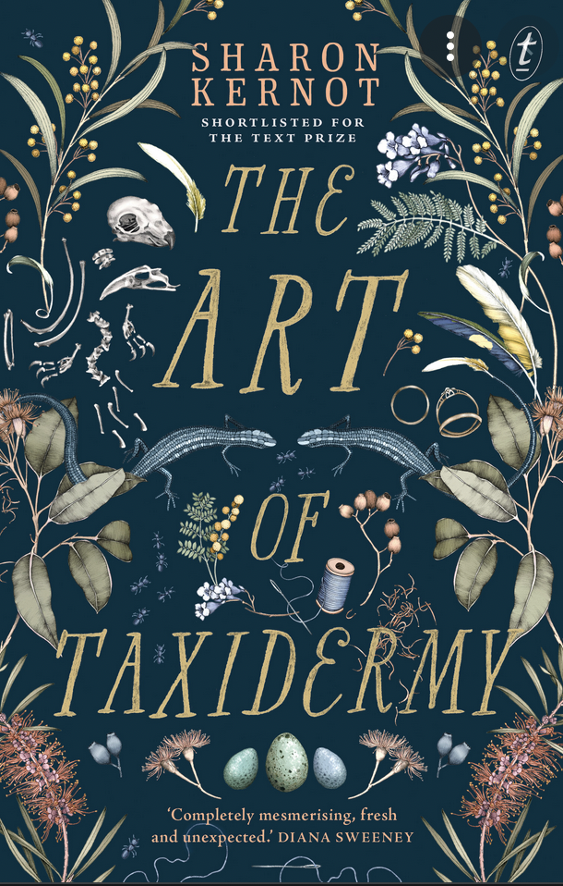
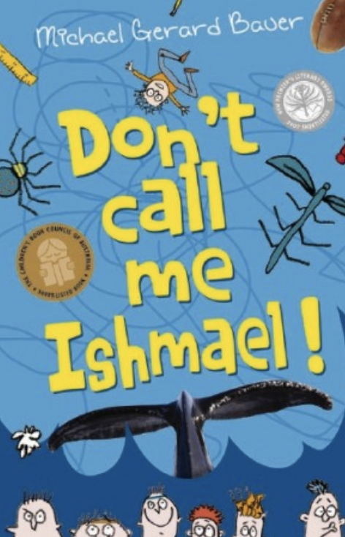
Exploring
Identity:
Forensic reading of opening scenes of these novels or others...
Various media items:
Social media identities
Public and private
Celebrity
Notoriety
Generations
Poetry: Knock, Knock by D Beatty, performance poem and picture book and various poetry and song lyrics
TV: episodes of Australian Story, Foreign Correspondent, The Family Law or Modern Family...​

Slide 23
Concluding messages
Different approaches for different contexts
Offer choice and increased independence
Opportunities for students to see themselves and others in the novels they read (diverse reading experiences)
Promote independent reading and reading for pleasure (studies of novels to compliment and not compete with this goal).
Notes:
Both of us – 2 min

Slide 24
Q&A Time permitting
AATE Bookshop
www.aate.org.au/resources/aate-bookshop
erika.boas1@gmail.com

